Slide 1
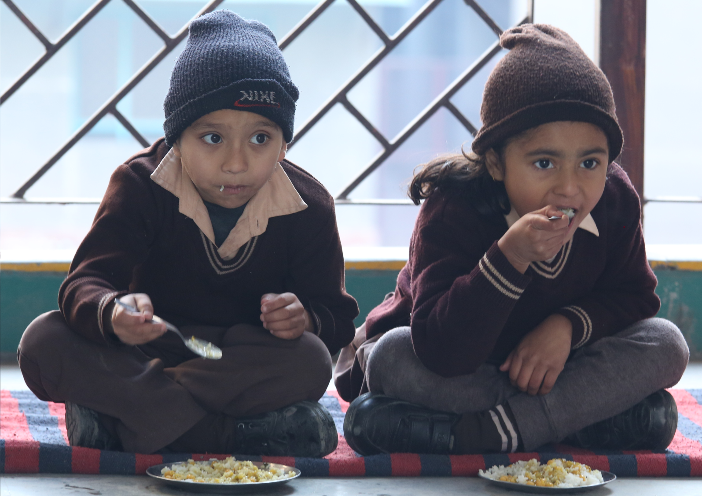
ANNUAL WORK PLAN & BUDGET 2019-20
MDM- PAB Meeting- DELHI on 06.05.2019

Slide 2
INTRODUCTION / BACKGROUND :
Mid Day Meal Scheme Centrally Sponsored Scheme of Ministry of HRD, Govt. of India.
Cooked Mid Day Meal is provided to the children of primary and upper primary classes of Govt. & Govt. Aided Schools through 54 Service Providers having semi automated kitchens for preparation of meal.
Implemented through Six implementing agencies i.e. DOE, 3MCDs, NDMC and DCB.
Dte. of Education is the Nodal Office for implementation of MDM Scheme in Delhi.

Slide 3
Enrolment (as on 30/09/2018) ___________________________________________________________________________________
Name of Department | No. of Schools | No of students (I- V) | No of students ( VI – VIII)
DOE & Aided Schools/AIE Centers | 1203 | 154714 | 676076
South MCD | 605 | 267721 | 0
North MCD | 738 | 328453 | 0
East MCD | 378 | 176939 | 0
NDMC | 45 | 12632 | 6844
DCB | 6 | 2100 | 900
Total | 2975 | 942559 | 683820
Total Coverage | 16.26Lakhs

Slide 4
Financial Norms (MHRD)
Food grains from FCI (wheat/rice) @ 100 gms & 150 gms per child per day for Primary and Upper Primary
The transportation cost of the food grains from FCI Depot to the kitchen @ Rs. 75/- per quintal
Honorarium of Rs. 1000/- per month paid to the Cook-cum-Helpers
(i) Cooking Cost for Primary per Student Rs.4.35/-
(ii) Cooking Cost for Upper Primary per Student Rs.6.51/-

Slide 5
Menu of MDM of DoE
Wheat based items: -
1. Atta & Besan Poori with Aaloo Curry/or Mixed Vegetables.
2. Atta Poori with Chholley(mashed vegetables added to the gravy)
3. Paushtik Daliya
Rice based items:-
1. Rice Chholley with mashed vegetables added to the gravy
2. Rice with Sambar/Dal (with vegetables added to the gravy)
3. Rice with Kadhi(with vegetables added to the gravy)

Slide 6
Monitoring
1. School Level MDM Committee constituted comprising of HOS, Teacher In-charge MDM, Home Science Teacher, three mothers of students, DDO & one SMC Member.
To check any contamination in meal, food is tasted by the members of the committee before distribution of food among the students.
2. School Management Committee (SMC) also monitor the implementation of the Mid Day Meal Scheme and to ensure that it meets the hygienic standards as specified by the department.
3. Directorate of Education vide circular dated 25/04/2014 has constituted a Grievances Redressal Committee in each District of Education under Sec-32 of the Right of Children to Free and Compulsory Education Act (RTEA) 2009

Slide 7
Monitoring (Cont…)
4. Directorate of Education has engaged the FICCI Research and Analysis Centre for testing the samples of cooked Mid Day Meal and raw food grains w.e.f. February. 2016.
4 samples per month (three from schools and one from kitchen) of each service provider are lifted and tested by FICCI Research and Analysis Center.
One sample of food grain (at the time of lifting from FCI) is also lifted for the testing it’s quality.

Slide 8
Monitoring (Cont…)
Month of sample lifting | Total No. of Sample lifted (by FICCI Lab) | Total No. of sample below norms in nutritive values
April, 2018 | 129 | 82
May, 2018 | 127 | 40
July, 2018 | 119 | 49
August, 2018 | 120 | 44
September, 2018 | 118 | 40
October, 2018 | 116 | 33
November, 2018 | 125 | 40
December, 2018 | 125 | 42
January, 2019 | 124 | ……..
February, 2019 | 125 | ……..
March, 2019 | 45 | ……..
Total | 1273 | 370
Total Rs.91750/- of Penalty imposed on all Service Providers on account of less nutritional value in MDM .
5. Inspections of the kitchens by DDE (Zones) twice a month 354 inspections carried out in 2018-19.

Slide 9
New initiatives:
Milk is being distributed to the students of 06 schools of Directorate of Education by M/s Mother Dairy on pilot basis.
RFP has been floated for empanelment of fresh Service Providers for supply of MDM.
Tender has been floated for empanelment of fresh NABL Accredited Lab for testing of meal.

Slide 10
New Proposals to supplement Mid Day Meal
Keeping the objective of improving upon the nutritional indices of growing children in mind, decision has been taken for providing of banana twice a week as a supplement with MDM for which inviting of tender is under process.

Slide 11
Automated Monitoring System (AMS)
Name of the Agency | Status of schools uploading AMS (Aprox.) | Comments for not/less Uploading
Directorate of Education | 90% | Uploading less by Aided Schools
North MCD | 85% | Due to technical problems.
NDMC | 100% | -----
East MCD | Not started | Due to technical problems. (however started w.e.f. 29.04.2019 but not reflecting)
South MCD | Not started | Due to technical problems
DCB | Not started | Due to technical problems

Slide 12
Coverage under School Health Programme
No. of Students upto 12th
No of schools covered under SHP | Health check up carried out | Distribution of IFA Tablets | Distribu-tion of Vitamin-A Tablets | Distribu-tion of De-worming Tablets | Free Spectacles distributed
2997 | 861314 | 1626379 | NA | 1626379 | 8529

Slide 13
Hand Washing

Slide 14
Expenditure Review 2018-19 (Component wise included unspent of 2017-18)
Rs. In Lakhs)
S. No. | Component | Release |  | Expenditure |  | Total Release | Total Expenditure
 |  | Central Share | State Share | Central Share | State Share
1 | Cost of Food grains | 876.62 | ….. | 715.21 | …… | 876.62 | 715.21
2 | Cooking Cost | 7506.57 | 6489.36 | 6019.22 | 5983.11 | 13995.93 | 12002.33
3 | Honorarium to Cook-cum-Helper | 1142.16 | 761.43 | 1093.68 | 729.11 | 1903.59 | 1822.79
4 | Transportation Assistance | 262.19 | …. | 254.29 | ….. | 262.19 | 254.29
5 | MME | 169.36 | …. | 119.73 | …… | 169.36 | 119.73
6 | Kitchen Devices | 0 | 0 | 0 | 0 | 0 | 0
Total |  | 9956.9* | 7250.79** | 8202.13 | 6712.22 | 17207.69 | 14914.35
*Included 1142.21 Lakh which yet to be released by Finance Department, GNCTD .
**Included 350.56 Lakh which yet to be released by Finance Department. GNCTD

Slide 15
Budget Provision for 2019-20 __________________________________________________________________________________
(Rs. In Lakhs)
S. No. | Component | Provision 2019-20 |  | Total
 |  | Central share 60% | State Share 40%
1 | Cost of Food grains | 1058.99 | ….. | 1058.99
2 | Cooking Cost | 9305.16 | 6203.44 | 15508.6
3 | Honorarium to Cook-cum-Helper | 1148.16 | 765.44 | 1913.6
4 | Transportation Assistance | 317.70 | ….. | 317.70
5 | MME | 319.41 | …… | 319.41
 | Total | 12149.42 | 6968.88 | 19118.30

Slide 16
Reason for increase in Budget Proposal for 2019-20 __________________________________________________________________________________
(Rs. In Lakhs)
The reasons are :-
i) Increase in enrolment of students from 16.12 Lakhs to 16.26 Lakhs
ii) Proposed increase in cooking cost by 5.35% tentative.

Slide 17
THANKS

